Slide 1
Supplemental Specification 802: Constructing and Inspecting Pipe Culverts, Sewers, Drains and Drainage Structures
Ted Strickland, Governor
Jolene Molitoris, ODOT Director
John Stains, P.E.
Roadway Hydraulics Engineer
Central Office, Hydraulics Section

Slide 2
Performance vs. Method Specs
ODOT has historically used Method Specs
603/604 details excavation, bedding and backfill materials and methods of compaction
SS 802 allows the contractor to determine means and methods

Slide 3
Other ODOT Performance Based Specifications
SS 832: Temporary Sediment and Erosion Control
441: Contractor Mix Design and Quality Control- Asphalt Concrete

Slide 4
SS 802 Development
Originally introduced in 2005
Optional on all projects, required on one trial project
Rewritten in 2008
Collaboration between Hydraulics, Construction Administration, OCA and Pipe Manufacturers
Implemented in Pilot Program 2009

Slide 5
Purpose of SS 802
Take advantage of efficiencies in time and cost by allowing the contractor to choose method of installation
Encourage innovative and creative construction techniques
Allow for new pipe materials to be introduced

Slide 6
Goals
Fully implement SS 802 on all projects by the end of 2010
Integrate inspection data into culvert inventory
 | Type A (lf) | Type B (lf) | Type C (lf) | Total (lf)
FY 2007 | 32,829 | 202,226 | 100,207 | 335,262
FY 2008 | 16,463 | 199,352 | 82,596 | 298,411
FY 2009 | 19,908 | 194,880 | 83,295 | 298,082
FY 2010 | 16,656 | 137,484 | 80,466 | 234,607

Slide 7
Elements of SS 802
Develop installation plan
Construct pipe and drainage structures according to installation plan
Inspect pipe and drainage structures 30 days after construction
Repair any defects at no additional cost to Department

Slide 8
Approved Materials
Conduit material specifically detailed in the plans or listed in the specification by installation type
Drainage structure materials listed in the specification
Bedding and backfill material listed in the specification
All other materials as listed in the specification

Slide 9
Installation Plan
Trench and excavation geometry
Identify all cut and fill installations
Identify bedding and backfill material
Identify lift thickness, compaction equipment and compaction density
Conduit type, size and type of drainage structures
Maximum joint gap
Other details as needed

Slide 10
Installation Plan
Provide written confirmation from the conduit manufacturer that the pipe material and strength supplied are appropriate for bedding and backfill material and density
All deviations during construction require the installation plan to be revised

Slide 11
Installation Plan Deviations
Deviations during construction require a revision to the installation plan to be submitted, with manufacturer confirmation
Revisions required to be submitted within 5 days
If revision does not receive confirmation, all installation will be replaced

Slide 12
Construction Inspection
Construction inspection forms for conduit and drainage structures certified and submitted by a representative of the Contractor to the Engineer
Deviations from installation plan are identified
ODOT inspector role to ensure installation plan is being followed

Slide 13
Post Construction Inspection
Perform inspection no sooner than 30 days after the completion of finished grade
Inspect all structures and entire length of all conduit
May be performed before paving
Perform remote or manual inspection of all conduit

Slide 14
Post Construction Inspection
Manual Inspection | Remote Inspection
Conduits with a rise of 48 inches and greater | Conduits with a rise of 12 inches or greater up to 48 inches
All Non-circular conduit | Conduits with a rise less than 12 inches as directed by Engineer
All Drainage structures

Slide 15
Manual Inspection
Provide a video recording of the entire run of conduit
Measure the deflection of flexible conduit
  Take three measurements in each segment
  Report smallest diameter of each segment of the run

Slide 16
Manual Inspection
Measure crack width of rigid conduit
  Record location, length and greatest width of each crack
Measure joint gap of all conduit
  Record widest gap in each joint
Measure greatest width of separation of manufactured seams

Slide 17
Remote Inspection
Use crawler mounted camera to record video of all conduit
Make measurements using equipment described in SS 902 for conduit materials as follows:

Slide 18
Remote Inspection
Conduit Material | Measurement Equipment | Type of Measurement
Rigid conduit and Mortar lined CMP | Crawler mounted camera with laser profiler* | Joint gaps Crack widths
Plastic | Crawler mounted camera with laser profiler | Joint gaps Crack widths Deflection
Ductile Iron and Steel Casing pipe | Crawler mounted camera with laser profiler | Joint gaps Crack widths Deflection
Bituminous Coated and Lined CMP, Spiral Rib CMP | Crawler mounted camera with laser profiler | Joint gaps Crack widths Deflection
Circular CMP | Mandrel | Deflection
*crack and defect measuring tool only

Slide 19
Crawler Mounted Camera
Equipment requirements in SS 902.01
Crawler with adjustable camera height, all wheel drive, adjustable speed
Camera with zoom, pan and tilt, light source
Digital video

Slide 20
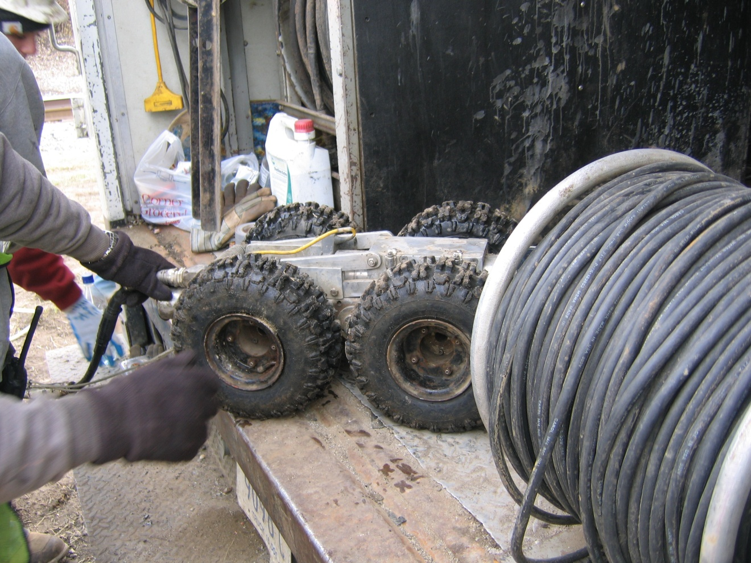
Crawler Mounted Camera

Slide 21
Crawler Mounted Camera with Laser Profiler
Equipment requirements in SS 902.02
Crawler/camera same as SS 902.01
Continuous laser ring “Scanner 3-D” laser profiler
Deflection calculated from actual interior circumference, not manually input

Slide 22
Crawler Mounted Camera with Laser Profiler
Calibration per ASTM E691 and E177
Automatic measurement and recording, unable to manually input or edit data
Crack and Defect measuring tool accurate to 1/32”
On screen calibration at each measurement

Slide 23
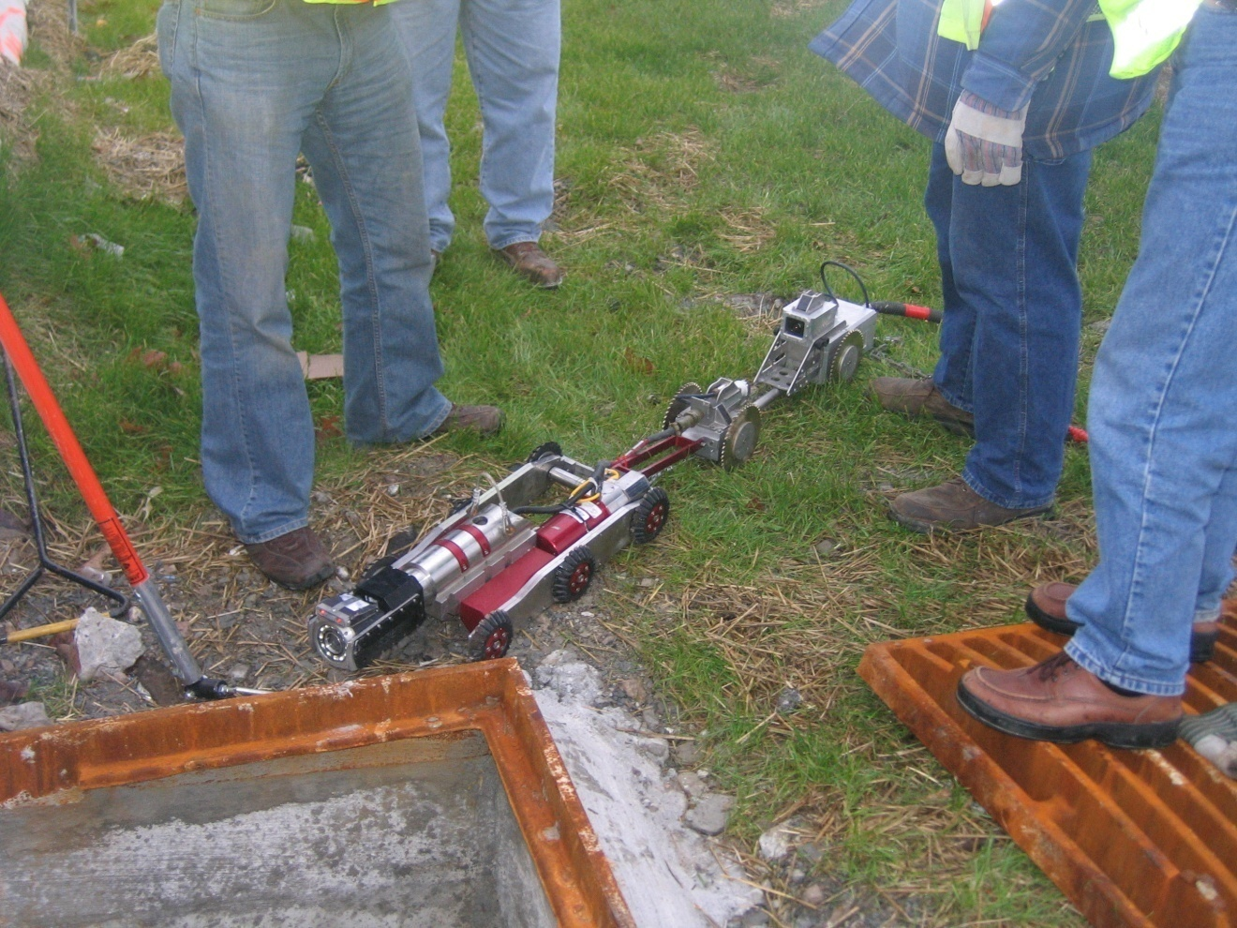
Crawler Mounted Camera with Laser Profiler

Slide 24
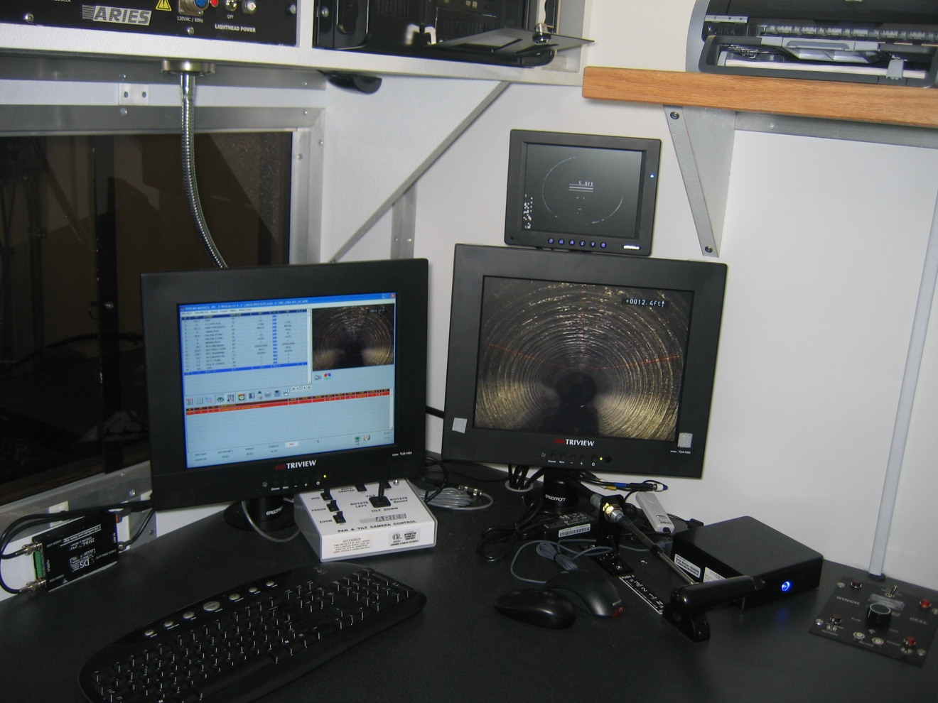
Control Station for Crawler and Laser Profiler

Slide 25
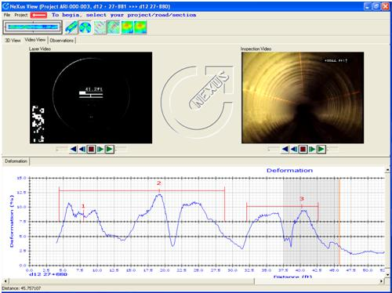
Laser Profiler Reporting

Slide 26
Conduit Repairs
Evaluate defects as required by AASHTO LRFD Bridge Construction Specifications
Evaluation performed by an independent, third party P.E.
AASHTO Section | Material Type
Section 26 | Metal Conduit
Section 27 | Concrete Conduit
Section 30 | Plastic Conduit

Slide 27
Conduit Repairs
If no repairs are necessary or required, submit following statement in the evaluation:
“I certify that repairs are not required for the conduit to function as designed and that the conduit meets the design life requirements described in the version of the Department’s Location and Design Manual, Volume 2, Drainage Design, used in the original design.”

Slide 28
Conduit Repairs
If repairs are necessary or required prepare a plan for repair with following statement:
“I certify that this repair plan was designed to ensure the repaired conduit will function as designed and will meet the requirements described in the version of the Department’s Location and Design Manual, Volume 2, Drainage Design, used in the original design.”

Slide 29
Conduit Repairs
Repair plans require written confirmation from the conduit manufacturer that repairs are appropriate
30 days after repairs are completed, inspect for effectiveness
Conduit repairs and additional inspections done at no additional cost to the Department

Slide 30
Conduit Repairs – Metal
Evaluate if infiltration is observed
Evaluate all racking or denting
Repair all damage to coatings
Evaluate if deflection > 5%
Repair or replace conduit if deflection >7.5%

Slide 31
Conduit Repairs - Rigid
Evaluate if infiltration is observed
Evaluate if cracks > 0.01 inch
Repair or replace conduit if cracks >0.10 inch
Repair or replace conduit if spalls or slabbing are observed

Slide 32
Conduit Repairs - Plastic
Evaluate if infiltration is observed
Evaluate if deflection > 5%
Repair or replace conduit deflection > 7.5%

Slide 33
Repair Methods – Flexible Pipe
Joints
Reround
Reline
Relay
Replace

Slide 34
Repair Methods – Rigid Pipe
Joints
Cracks
  Epoxy Inject
  Reline
Relay
Replace

Slide 35
Relining Methods
Slip lining
  SS 837 Construction Specification
  SS 937 Material Specification
Resin Based Liner – SS 834
Spiral Wound Profile – SS 841
Cured in Place Pipe
  Under development

Slide 36
Drainage Structure Repair
Evaluation performed by an independent, third party P.E.
Certifications, repair plan and inspection processes are the same as for conduit
Repairs and additional inspections performed at no additional cost to the Department

Slide 37
Drainage Structure Repairs
Defects Requiring Evaluation
Infiltration between drainage structure and conduit
Grate more than 0.1’ from documented station/offset or elevation
Invert elevation more than 1” or 5% diameter of the conduit, whichever is greater, from documented elevation
Grate does not seat properly in frame
Grate not placed on required slope
Grate or Frame broken or cracked
Steps do not line up
Drainage structure does not match standard construction drawing
Manhole top does not match plans

Slide 38
Basis of Payment
Payment for all inspections included in the contract price for the pay item
Payment for all required repairs are included in the contract price for the pay item
All required repairs must be completed prior to final acceptance

Slide 39
Basis of Payment
60% paid after installation of conduit or drainage structure
10% paid after performance inspection is completed
30% paid after acceptance of the conduit or drainage structure

Slide 40
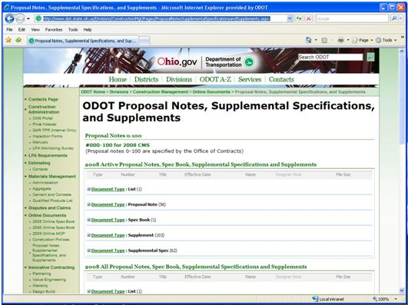
Where to find SS 802
All specifications available on Division of Construction Management Website
http://www.dot.state.oh.us/Divisions/ConstructionMgt/Pages/ProposalNotesSupplementalSpecificationsandSupplements.aspx

Slide 41
Contact Information
David Riley, P.E.
David.Riley@dot.state.oh.us
614-466-2599
John Stains, P.E.
John.Stains@dot.state.oh.us
614-728-1998
Becky Humphreys, P.E.
Becky.Humphreys@dot.state.oh.us
614-387-1125

